Slide 1
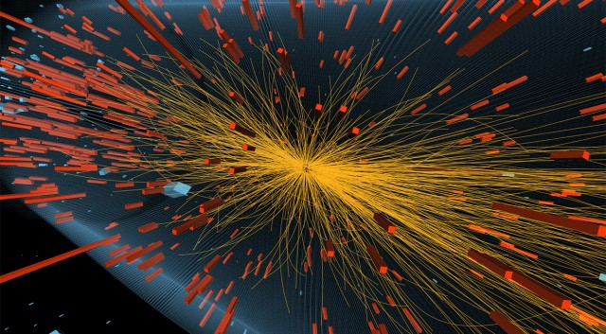
Simulating a Particle Detector

Slide 2
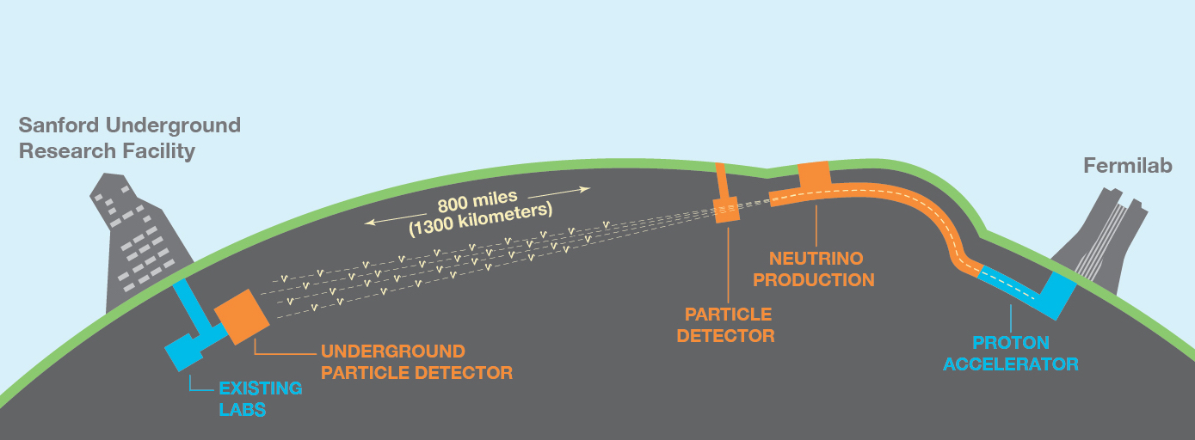
Why?
Check theoretical predictions
Save money during development
Look for new physics

Slide 3
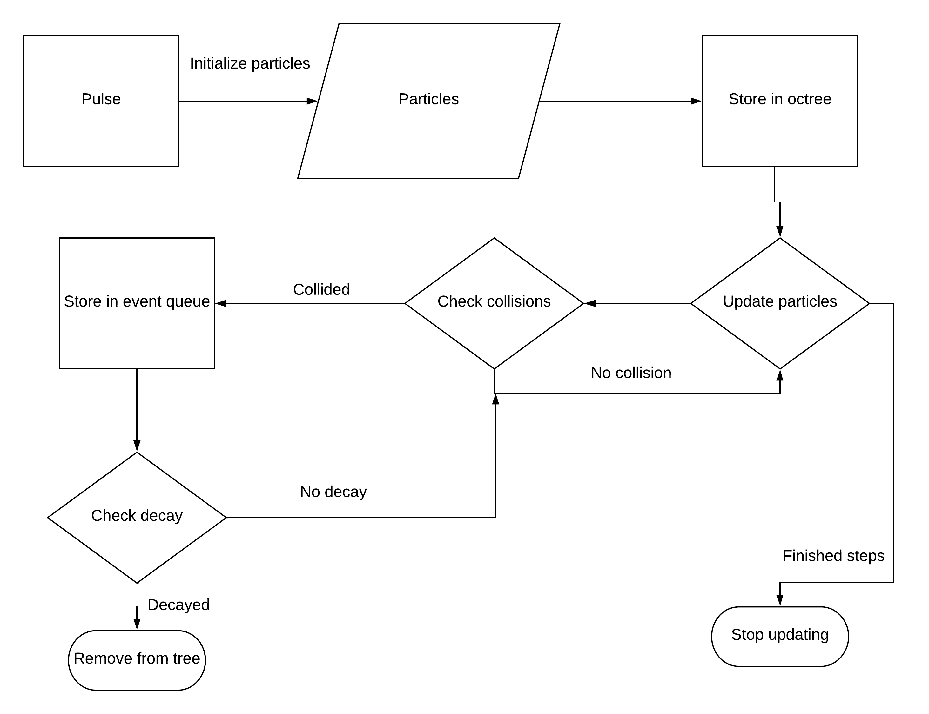
How does it work?

Slide 4
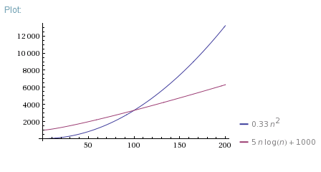
Collision check complexity
Drastically improves run time speed
More particles at once

Slide 5
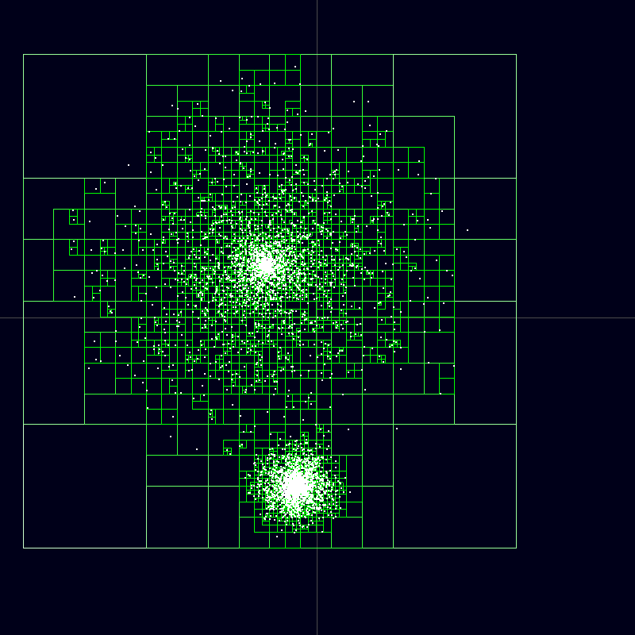
How was the complexity reduced?
The Barnes-Hut algorithm

Slide 6
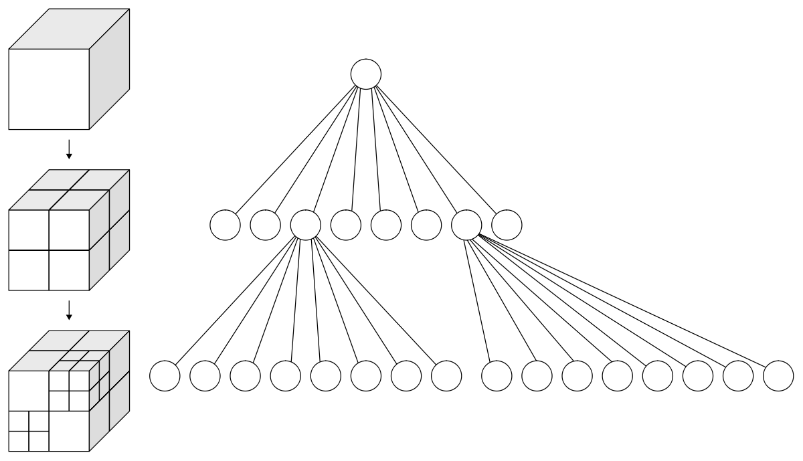
Octree

Slide 7
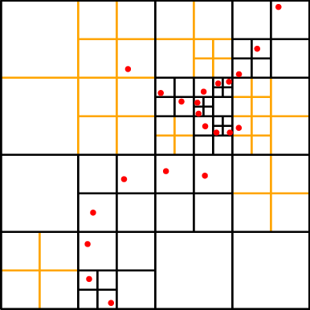
Octree properties
Data is stored in leaf nodes
Subdivide with 2 or more data objects
Fast querying

